Slide 1
3LS HP Performance Advisor Tutorial
3LS/ October 7th, 2021

Slide 2
What is HP Performance Advisor?
HP Performance Advisor (HPPA) is a graphical troubleshooting and diagnostic utility designed to quickly view a system's configuration and optimize it according to use case.
Notable Features Include:
Fine Tune Graphics Drivers and Key Applications with One Click
Quickly View System Specifications
Record and Identify Performance Bottlenecks By Process or Application

Slide 3
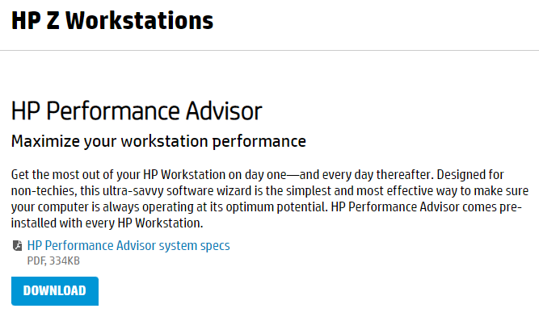
Installation Instructions
PREREQUISITE: Make sure you have an internet connection!
The HP Performance Advisor requires an internet connection to download, install, and operate.
Visit the download page for HP Performance Advisor
Or: Manually navigate to: https://www.hp.com/us-en/workstations/performance-advisor.html
Click on the blue "Download" Button
Navigate to your web browser's default download location
Run "Advisor.msi"
Follow the instructions on the HP Performance Advisor Setup Wizard
You can now run the HP Performance Advisor program

Slide 4
First Time Launch Procedure
What to do after installing and running HPPA for the first time

Slide 5
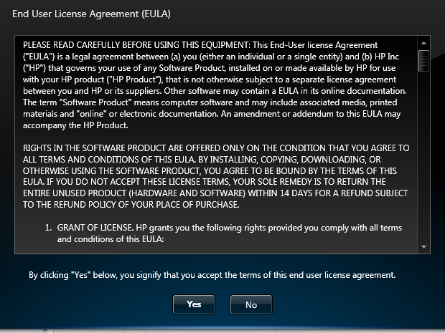
EULA
After installation, when you launch HPPA for the first time, you'll have to answer or accept a few prompts.
This only occurs upon your first launch of HPPA, and no other time.
The first prompt is the EULA
Read the EULA
Press "Yes" to accept the EULA

Slide 6
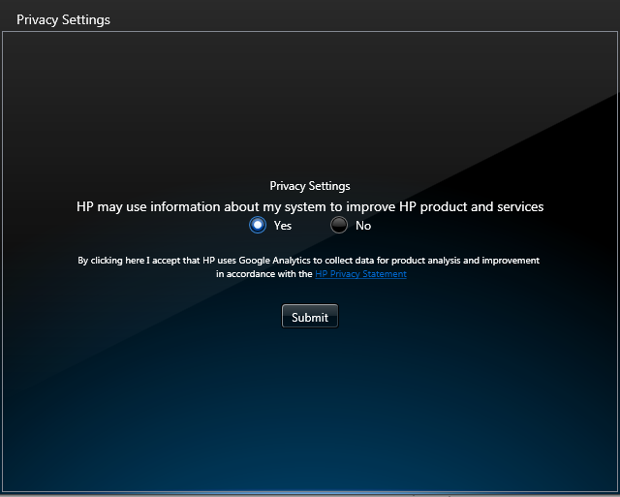
Privacy Settings
The next prompt is the Privacy Settings Opt-In
This allows HP to collect system data for analysis
Select the "Yes" or "No" radial button
Press the "Submit" button

Slide 7
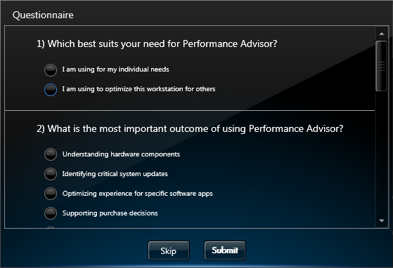
Questionnaire
The next prompt is the Questionnaire
Answer Question 1 by selecting the appropriate radial button for your use case
Answer Question 2 by selecting the appropriate radial button for your use case
Press the "Submit" button
OR
Press the "Skip" button to skip the questionnaire

Slide 8
Using HP Performance Advisor
An overview of how to use HPPA after installation, grouped by menu subdivisions

Slide 9
Main Menu
Items you'll see upon launching HPPA

Slide 10
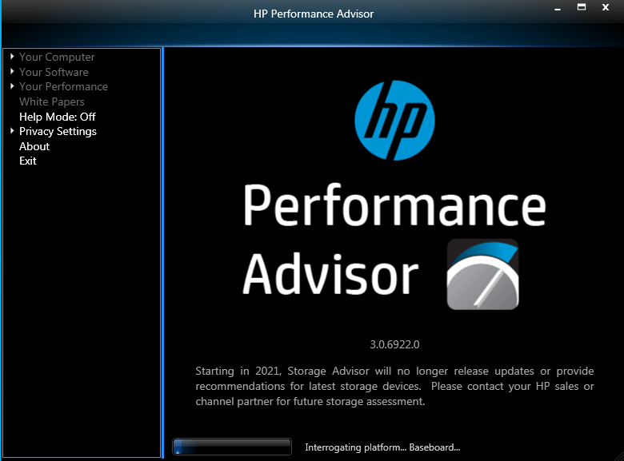
Platform Interrogation
After completing the First Time Launch Procedure (and after launching HPPA normally afterwards), the program will launch on the main menu
Each launch, HPPA will "Interrogate the platform"
This simply means that the program is querying the system for hardware specifications, software settings, and BIOS settings
When the progress bar at the bottom of the window completes, the sidebar options on the left will unlock

Slide 11
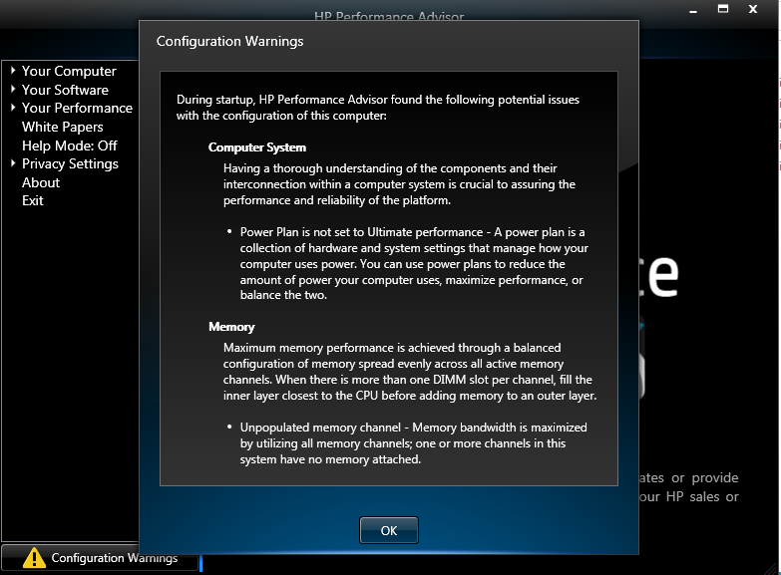
Configuration Warnings
After interrogating the system, a Yellow Warning Symbol may appear on the bottom left of the window.
See figure to the right
Clicking this "Configuration Warnings" button will bring up a window which states the potential configuration issues with the system
Depending on the number of issues present, you may have to scroll down to view them all
While little to no numeric data is present in this window, the summary of configuration issues may be useful in troubleshooting

Slide 12
The Sidebar
Navigating HPPA using the Sidebar

Slide 13
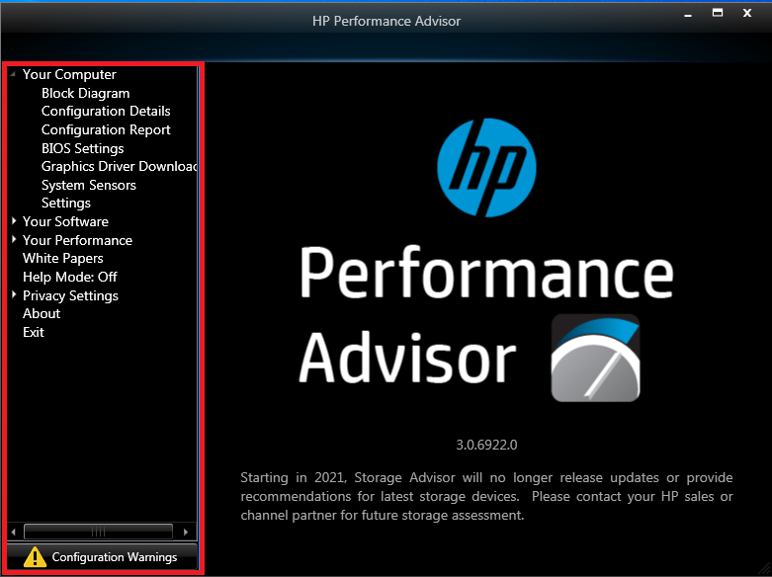
The Sidebar
The Sidebar is your main method of navigation
It is on the left side of the window
See figure to the right, the sidebar is highlighted in red
As mentioned before, certain options in the sidebar will only be accessible after platform interrogation
Selections with a triangle or chevron bullet point can be expanded to view more sub-selections

Slide 14
Your Computer
Selections under the "Your Computer" section of the sidebar

Slide 15
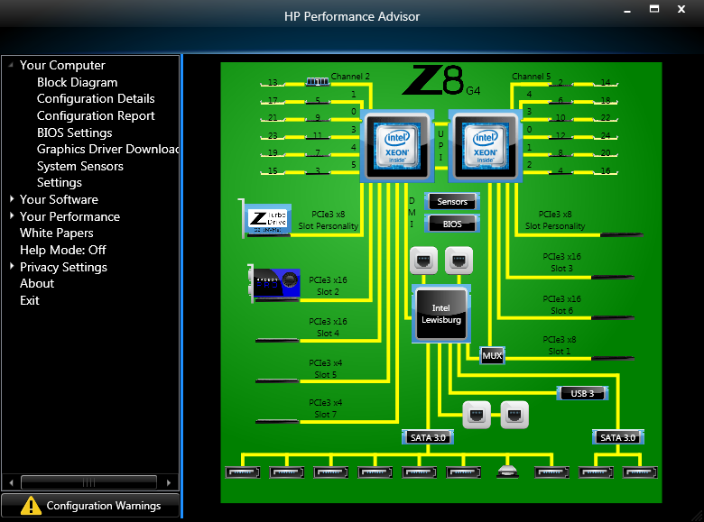
Block Diagram
The first item is the Block Diagram
See Figure (left)
It graphically delineates components in your system including:
CPU(s)
GPU(s)
RAM DIMM(s)
Chipset Controllers
Sensors
and more
You can click on a component to view detailed information about it
This will open a new window with the component's details

Slide 16
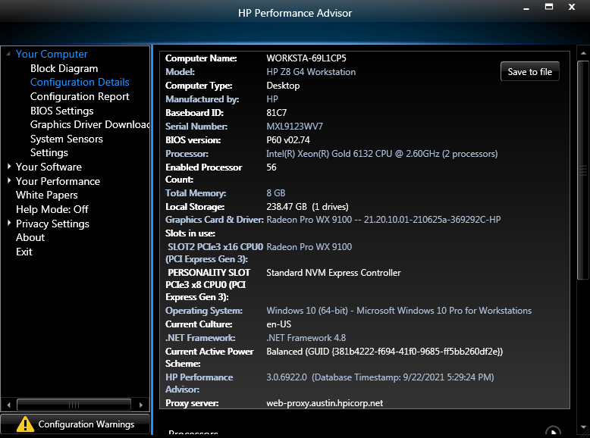
Configuration Details
The next item is the Configuration Details
This delineates your entire system configuration in text
This information can be exported to a text file by clicking the "Save to file" button at the top right of the window.
Some of the information you can see in this menu includes:
General System Summary
Processors
BIOS details
Graphics Card
System Memory
System Slots
Device Information
and more

Slide 17
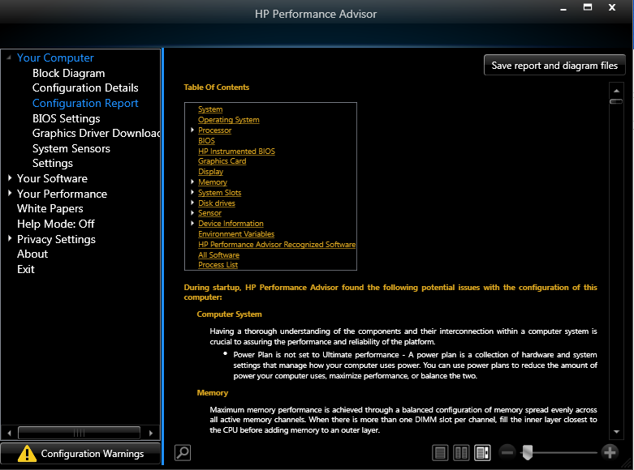
Configuration Report
The next item is the Configuration Report
It is an extremely detailed, hyperlinked report of EVERYTHING on the system
The report presents everything in text or as diagrams
This report can be exported to a .XAML file by pressing the "Save and report diagram files" button at the top right of the window
TIP: The "TOC" hyperlink found after each item header in the report stands for "Table of Contents" and will return you to the top of the report for easy navigation.

Slide 18
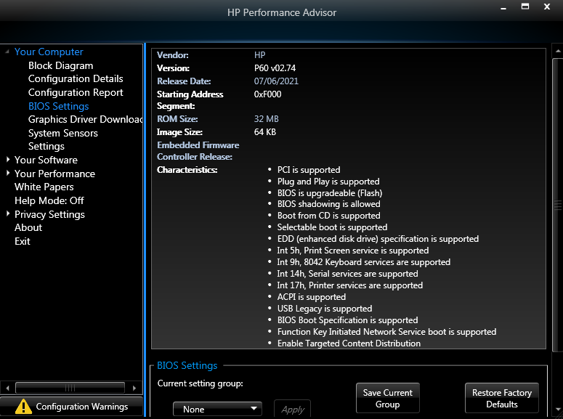
BIOS Settings
The next item is the BIOS Settings
It allows you to view and change the current BIOS settings without having to restart the system and enter the BIOS via F10
You save your chosen settings as a preset, which you can apply in one click later
It will appear under the "Current setting group" dropdown menu
You can also restore the BIOS to the system's factory defaults from this menu
Changes will NOT take place until the system is restarted

Slide 19
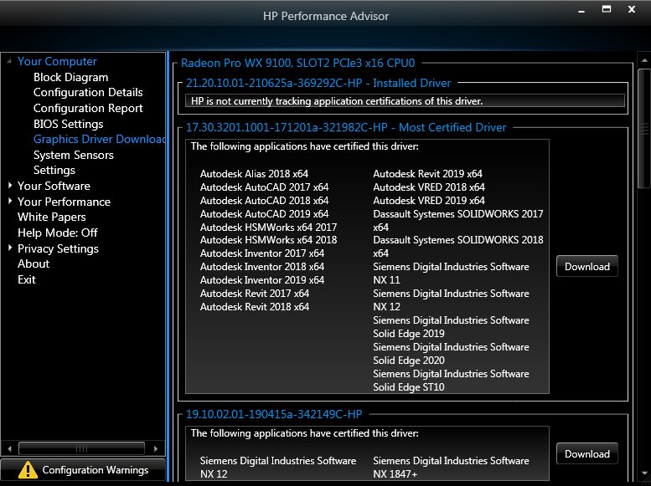
Graphics Driver Download
The next item is the Graphics Driver Download
From this menu, you can download HP qualified and vetted drivers without having to manually search for them using a web browser
You can download a driver by pressing the "Download" button next to it
Each driver has a description delineating which applications have certified the driver
This allows a user to quickly choose a driver best suited to their needs based on the use case
There may also be notes from HP attached on the driver
Example: "This driver comes directly from AMD and it has not been thoroughly tested by HP's Graphics Lab

Slide 20
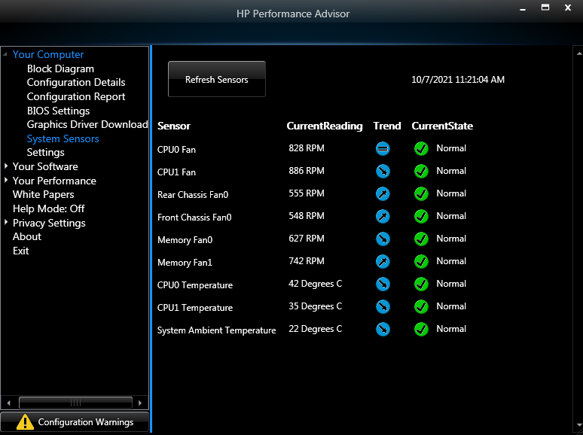
System Sensors
The next item is the System Sensors
This shows current readings and state of all the system's sensors
The data is not updated in real time, and represents the state of the sensors at the time HPPA was loaded
To get an immediate reading, press the "Refresh Sensors" button at the top left of the window
Initially, there will be no data in the "Trends" column, until the "Refresh Sensors" button is pressed
After the "Refresh Sensors" button is pressed, the "Trends" column will be populated with blue icons that represent in what direction a given statistic is trending

Slide 21
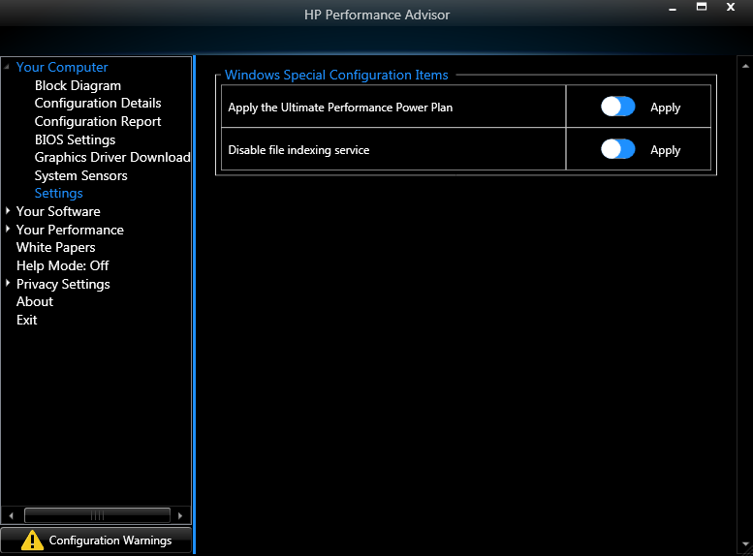
Settings
The next item is the Settings
More specifically, this menu includes toggles for Windows Special Configuration Items
You can enable or disable the following from this menu
Ultimate Performance Power Plan
File Indexing Service

Slide 22
Your Software
Selections under the "Your Software" section of the sidebar

Slide 23
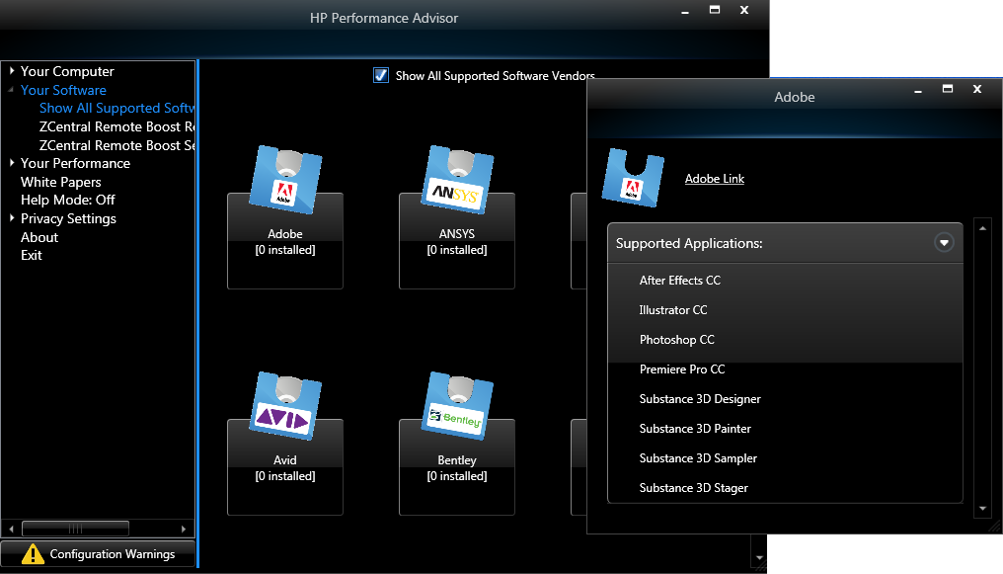
Show All Supported Software Vendors
The first item is the Show All Supported Software Vendors menu
Here you can see which software from supported vendors is installed on the system, categorized by vendor
Clicking on a vendor will show all supported applications from that vendor
You can toggle the "Show All Supported Software Vendors" checkbox at the top of the window to show only HP software, or all software

Slide 24
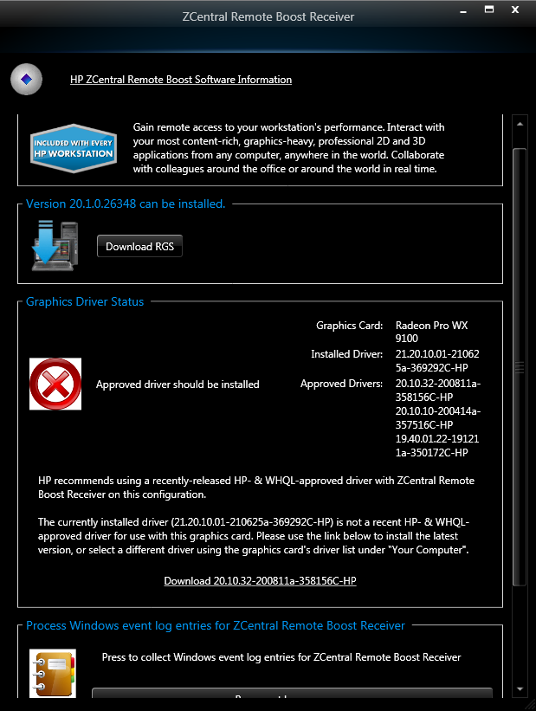
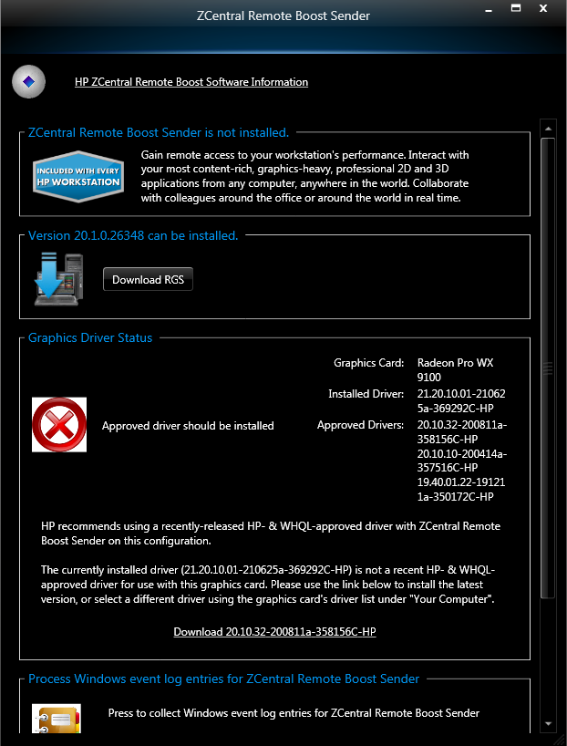
ZCentral Remote Boost Receiver and Sender
The next 2 items are ZCentral Remote Boost Receiver and ZCentral Remote Boost Sender
Here you can :
Install Remote Boost
Install an approved driver
Process Windows Event Log entries for the Sender/Receiver
Find a Workstation for Remote Boost
Clicking on either item in the sidebar will open a new window
See Figure (left) for Receiver and Figure (right) for Sender

Slide 25
Your Performance
Selections under the "Your Performance" section of the sidebar

Slide 26
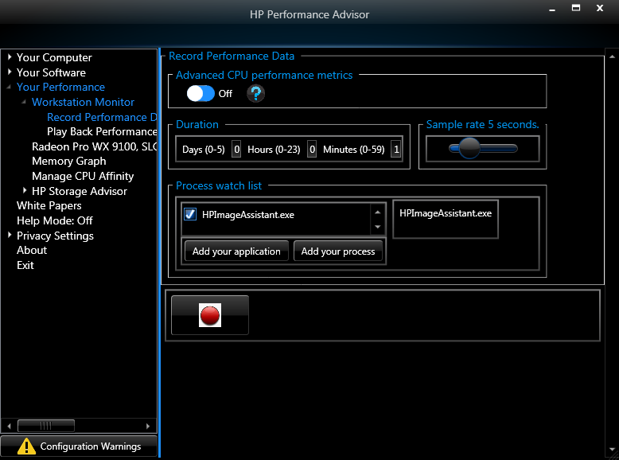
Workstation Monitor – Record Performance Data
This first item is Workstation Monitor, which has two sub-items: Record Performance Data and Play Back Performance Data
This menu allows you to select and record your chosen applications or processes and graphically view data like:
Total CPU usage
GPU Activity
Disk Activity
Ethernet
And more

Slide 27
Workstation Monitor – Record Performance Data
Steps to Record Performance Data
Determine which applications or processes you wish to monitor
Using the "Add your application" or the "Add your process" button, select your application or process
For Applications, navigate to the .exe with the Windows Explorer that pops up
For Processes, select your process using the radial button list that pops up
Configure your sample rate, duration, and advanced CPU performance metrics settings
Press the Red Circle button to begin recording
Run your applications and processes normally in Windows
When you're done, stop the recording by pressing the Red Circle button again

Slide 28
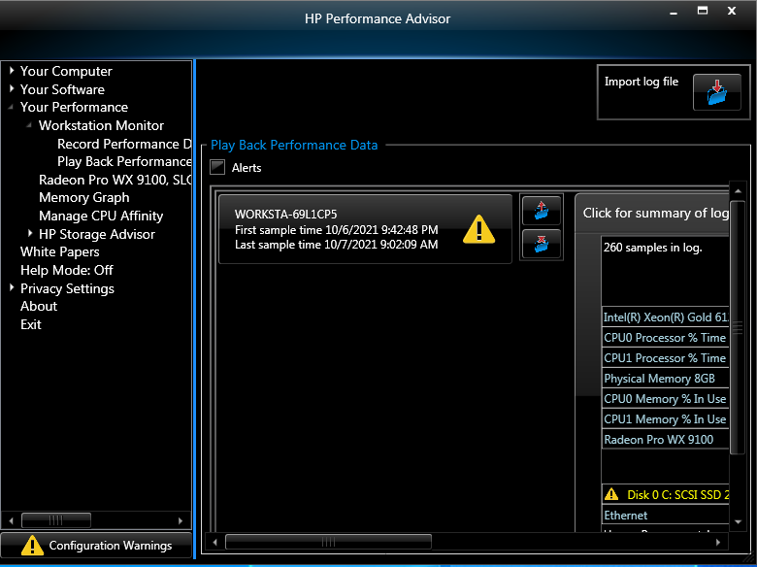
Workstation Monitor – Play Back Performance Data
The next item is the Play Back Performance Data menu
After you're finished recording your performance data, it will automatically save and be listed in this menu
Selecting the log file will open a new window with a graphical representation of the log file. This will contain statistics over time regarding utilization of hardware
Within this menu, there may be a Yellow Warning button, which you can click to view alerts generated during the recording
You can click for a tabular summary of the log file as well
You can import existing log files for analysis using the "Import Log File" button at the top right of the window

Slide 29
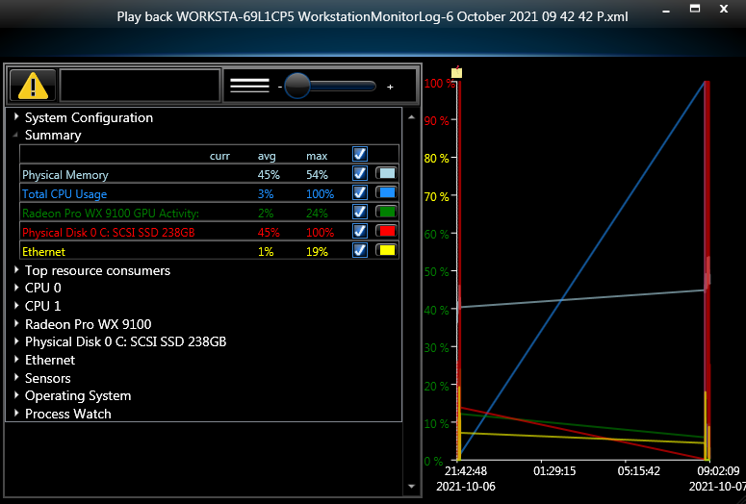
Workstation Monitor – Play Back Performance Data
The graphical representation of the log file recording

Slide 30
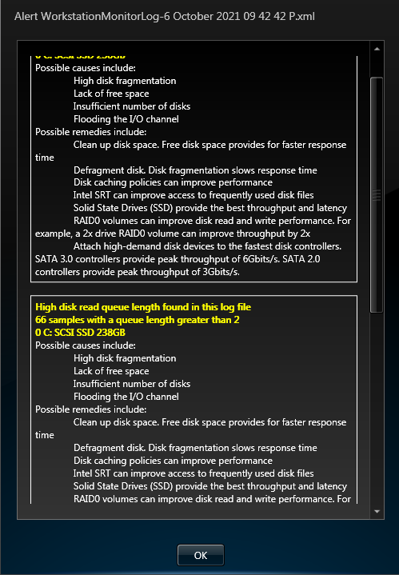
Workstation Monitor – Play Back Performance Data
Example of alert within graphical representation of log file recording

Slide 31
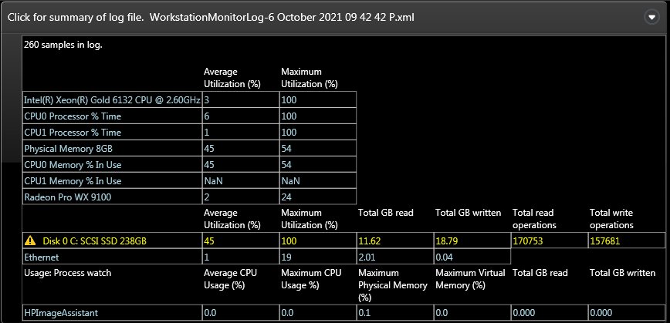
Workstation Monitor – Play Back Performance Data
The tabular representation of the log file recording

Slide 32
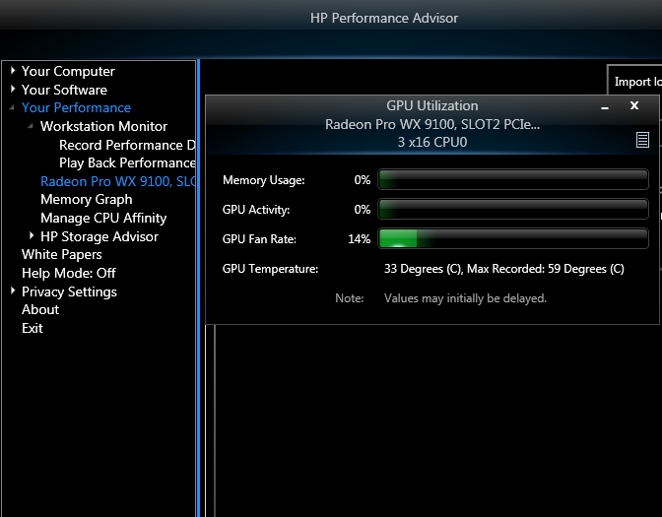
Graphics Card Monitor
The next item is the Graphics Card Monitor
This item will NOT appear as "Graphics Card Monitor"
It will appear as the name of your graphics card(s). In my case, it is "Radeon Pro WX9100..."
Clicking this will open a new window showing your GPU utilization, temperature, activity, fan rate, etc.

Slide 33
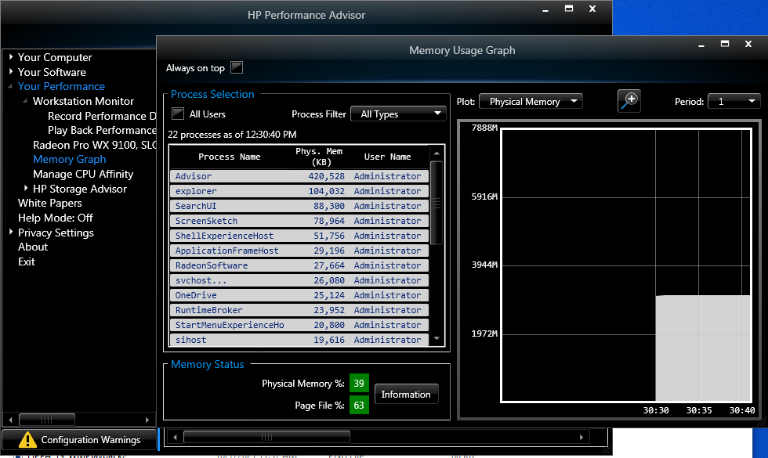
Memory Graph
The next item is the Memory Graph
This menu will allow you to view your memory utilization sorted by process using the most physical memory
There is also a plot showing physical and paged memory usage over time
You can filter the processes by user, and whether or not they're services, .NET, etc.

Slide 34
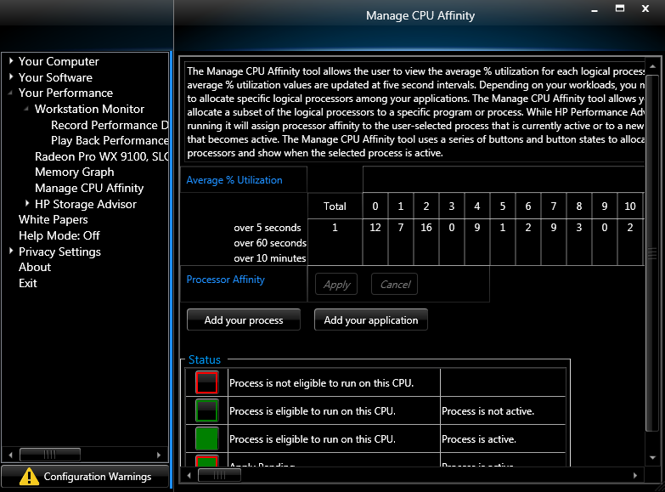
Manage CPU Affinity
The next item is the Manage CPU Affinity menu
This menu will allow you to view the average % utilization for each logical processor (CPU core)
You can also manually restrict a process or application to run on certain logical processors
To add a process or application
Using the "Add your application" or the "Add your process" button, select your application or process
For Applications, navigate to the .exe with the Windows Explorer that pops up
For Processes, select your process using the radial button list that pops up
Select which logical processors you'd like your app/process to run on by click the Green Squares
You can use the "All" checkbox to select or deselect all logical processors
Press the "Apply" button next to "Processor Affinity"

Slide 35
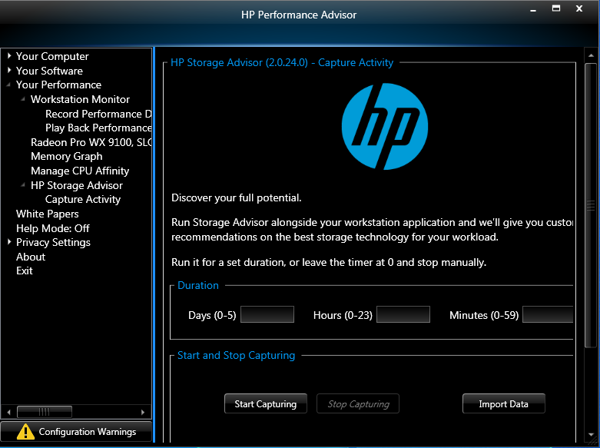
HP Storage Advisor – Capture Activity
The next item is HP Storage Advisor, which has 1 sub-item, Capture Activity
This is like the performance monitor but will focus on File IO and determine what sort of storage solutions will work best for a given system.
To enable and run:
Click on Capture Activity
Accept any prompts that appear
Wait for the download to finish
Configure any duration settings if desired
Press the "Start Capturing" button
Process your file IO normally
When you're ready to stop, press "Stop capturing"

Slide 36
Other Items
Items in the sidebar that don't warrant having their own section

Slide 37
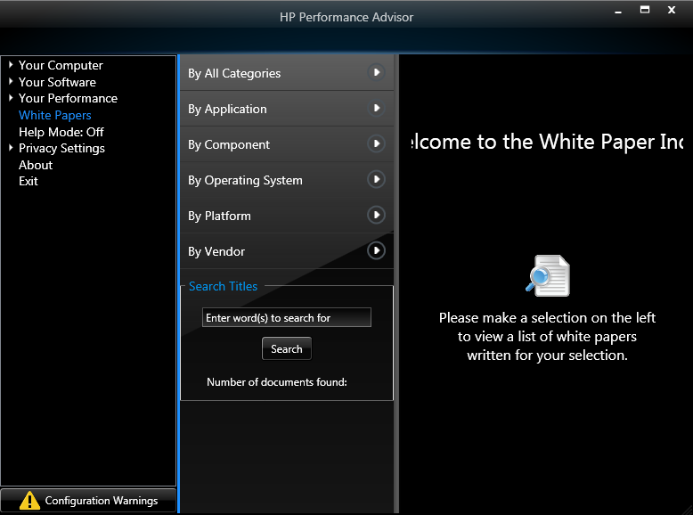
White Papers
The first item is the White Papers
This is a collection of all manuals, datasheets, guides, and quickspecs that are relevant to your system
You can search for keywords in the titles of the white papers using the search bar

Slide 38
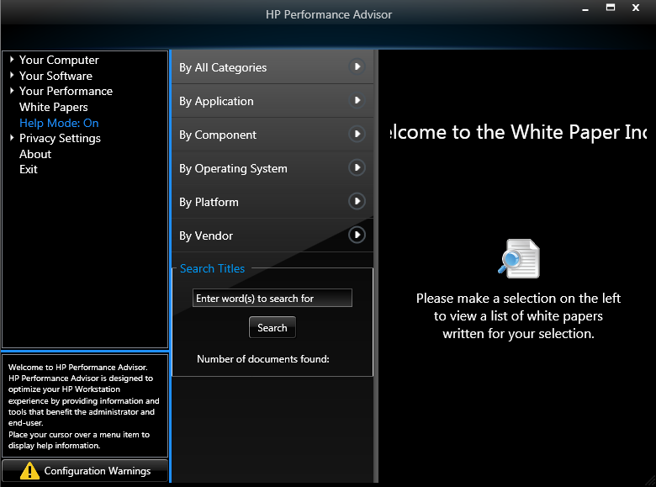
Help Mode
The next item is the Help Mode toggle
Clicking "Help Mode: Off" will toggle Help Mode to "Help Mode: On". Clicking again will turn Help Mode off.
When help mode is on, at the bottom of the side bar, a text box with help information will appear when hovering over a given sidebar item.

Slide 39
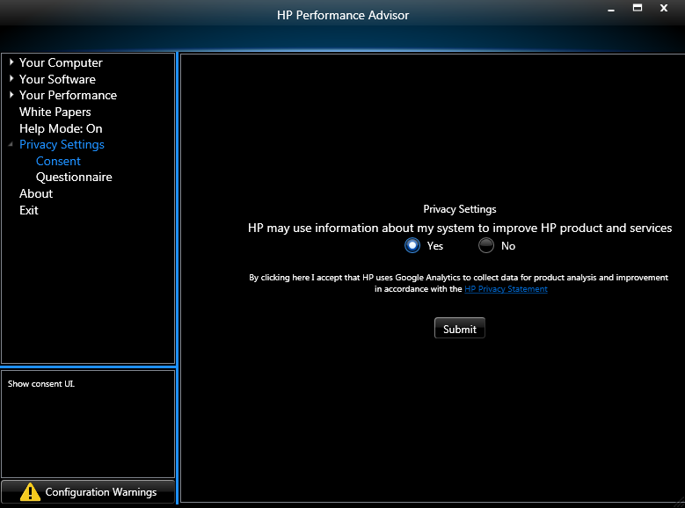
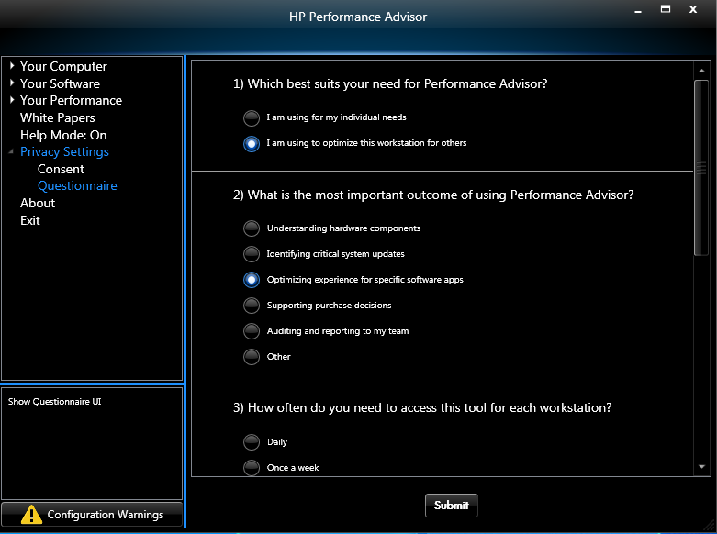
Privacy Settings – Consent & Questionnaire
The next item is Privacy Settings with 2 sub-items: Consent and Questionnaire
The Consent menu (left) is the same as the consent menu when launching HPPA for the first time
The Questionnaire (right) is an expanded version of the questionnaire from the first time launch procedure

Slide 40
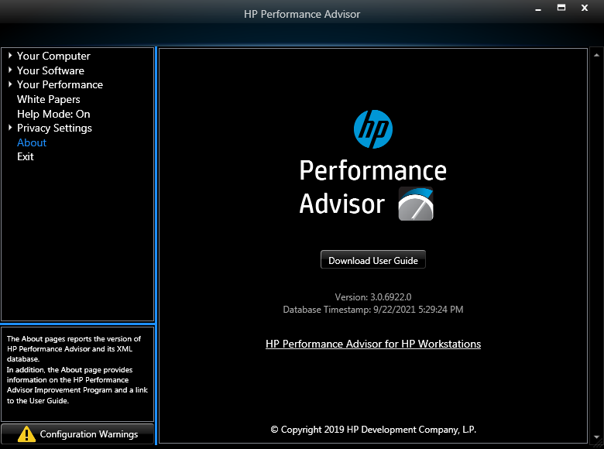
About & Exit
The next 2 items are the About menu and the Exit button
The About menu contains a download link to the user guide, the version number, and the database timestamp
The Exit button exits the application without prompt

